Slide 1
CUSTOMER & SALES INSIGHTS FOR E-COMMERCE GROWTH
By Francis Agbo

Slide 2
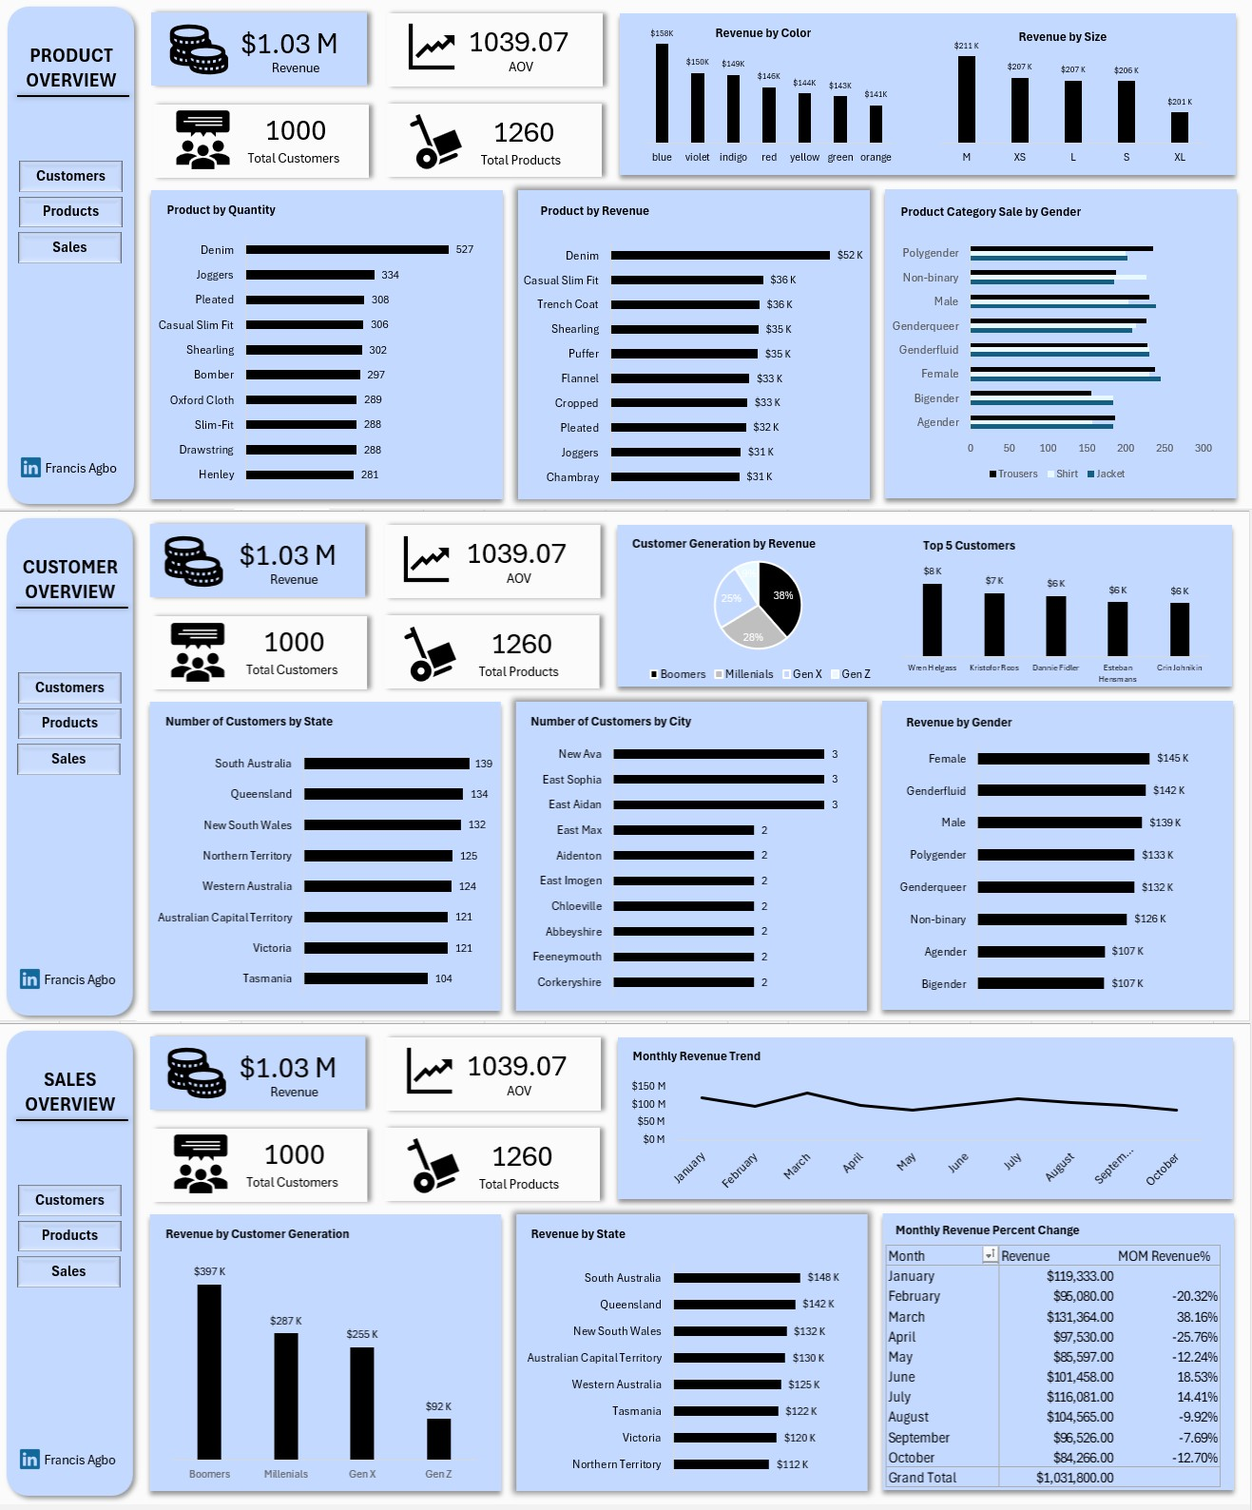
Dashboard Overview

Slide 3
Project Overview
Analyzed 10 months of sales data from an online store
Goal: Understand customer behavior, sales trend and products performance
Tools Used: SQL, EDA, Data Visualization

Slide 4
Key Objectives
Segment customers by demographics
Track revenue and monthly performance
Identify top selling products
Analyze geographic and demographic revenue
Monitor customer retention
Improve delivery and operational efficiency

Slide 5
Dataset Overview
Source: Synthetic kaggle dataset
4 interconnected tables (customers, orders, products, sales)
1000 orders, 1000 customers, 1260 products
No nulls or duplicates found

Slide 6
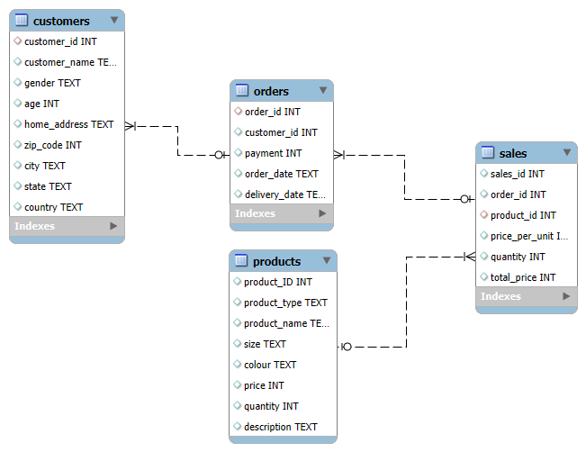

Slide 7
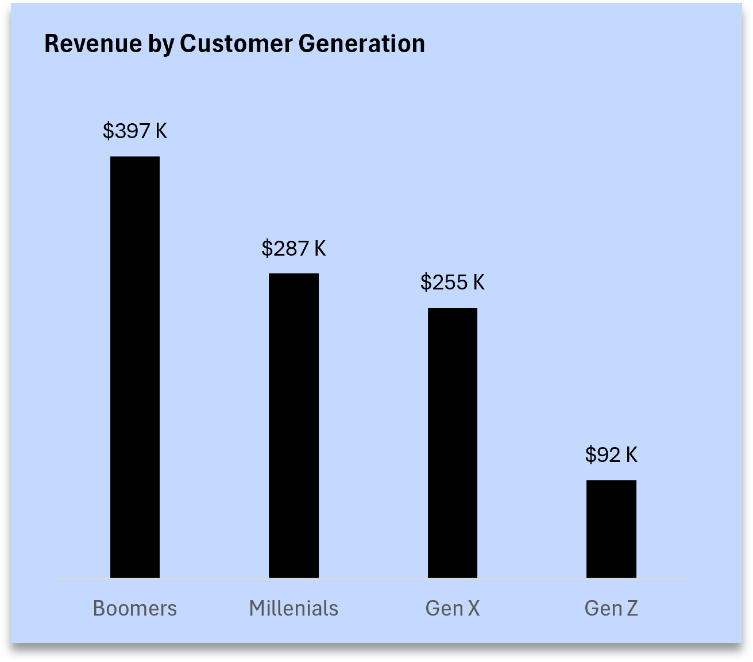
Key Findings
Bommer (57-80): Largest and most profitable group.
378 orders from 240 customers, generating $397,477.
Gen Z (9-24): Smallest customer base
92 orders from 55 customers, with $92,286 revenue.

Slide 8
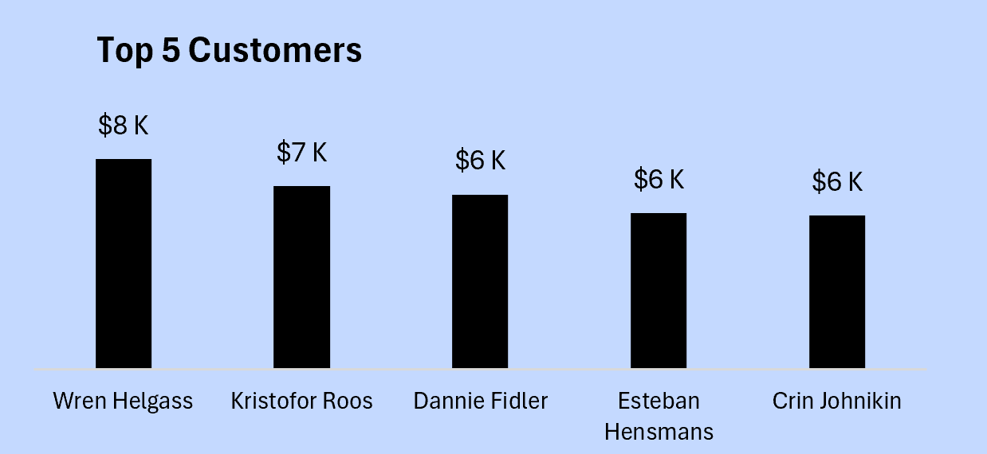
Key Findings
Total Revenue: $1,031,800
AOV: $1,038 per order
Total Orders: 1000
Top Customers: Wren Helgass with$7,632 from 5 orders

Slide 9
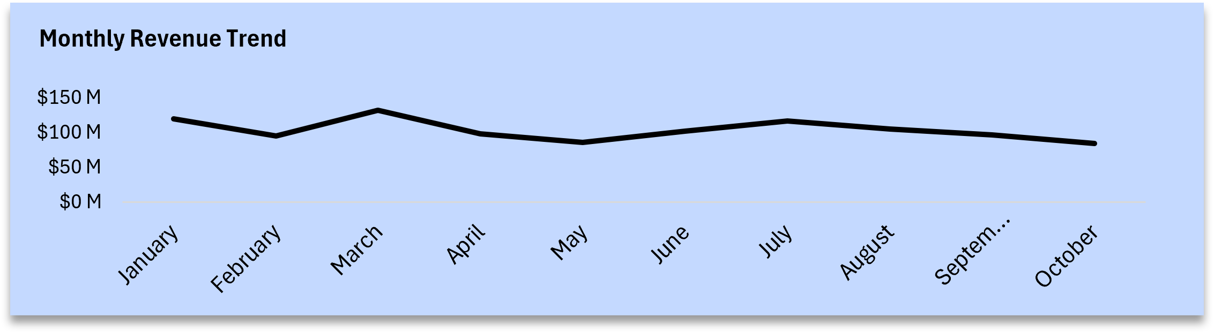
Key Findings
Revenue was highest in March ($131,364) followed by January and July
Most months had negative growth except:
March (+38.16%)
June (+18.53%)
July (+14.41%)

Slide 10
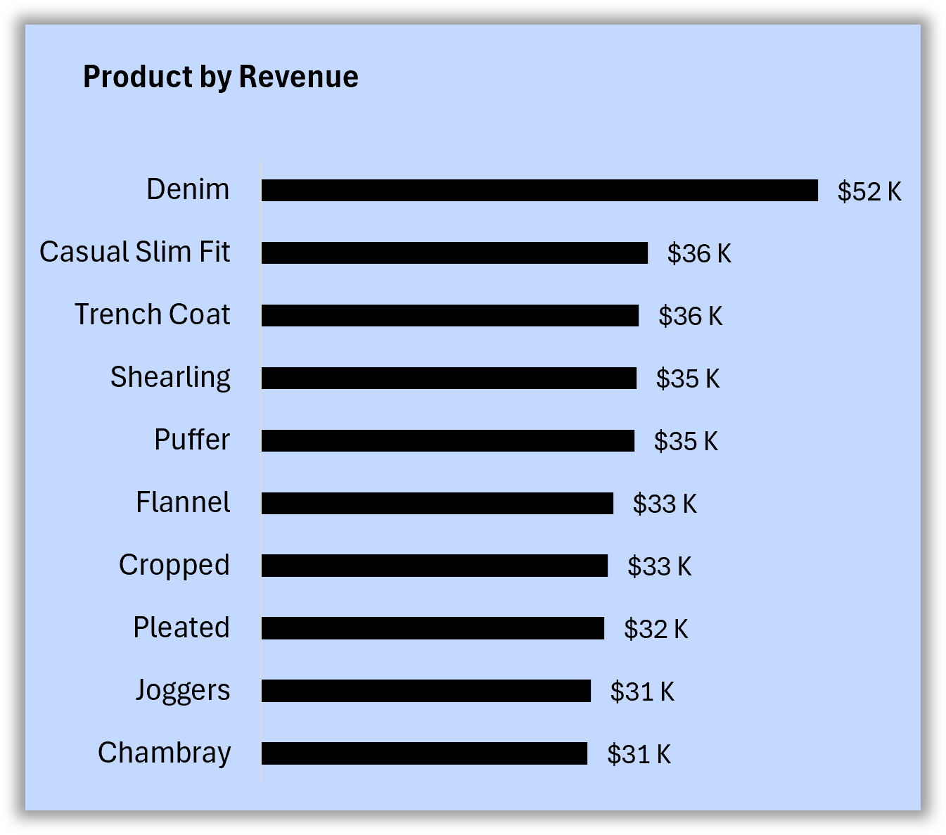
Key Findings
Top selling products (units):
Denim (527), Joggers (334), Pleated (308)
Top products by revenue:
Denim ($52,399), Casual slim fit ($36,414), Trench Coat ($35,581)
Insights: Joggers sold many units but ranked low in revenue, likely due to discounting or low price point

Slide 11
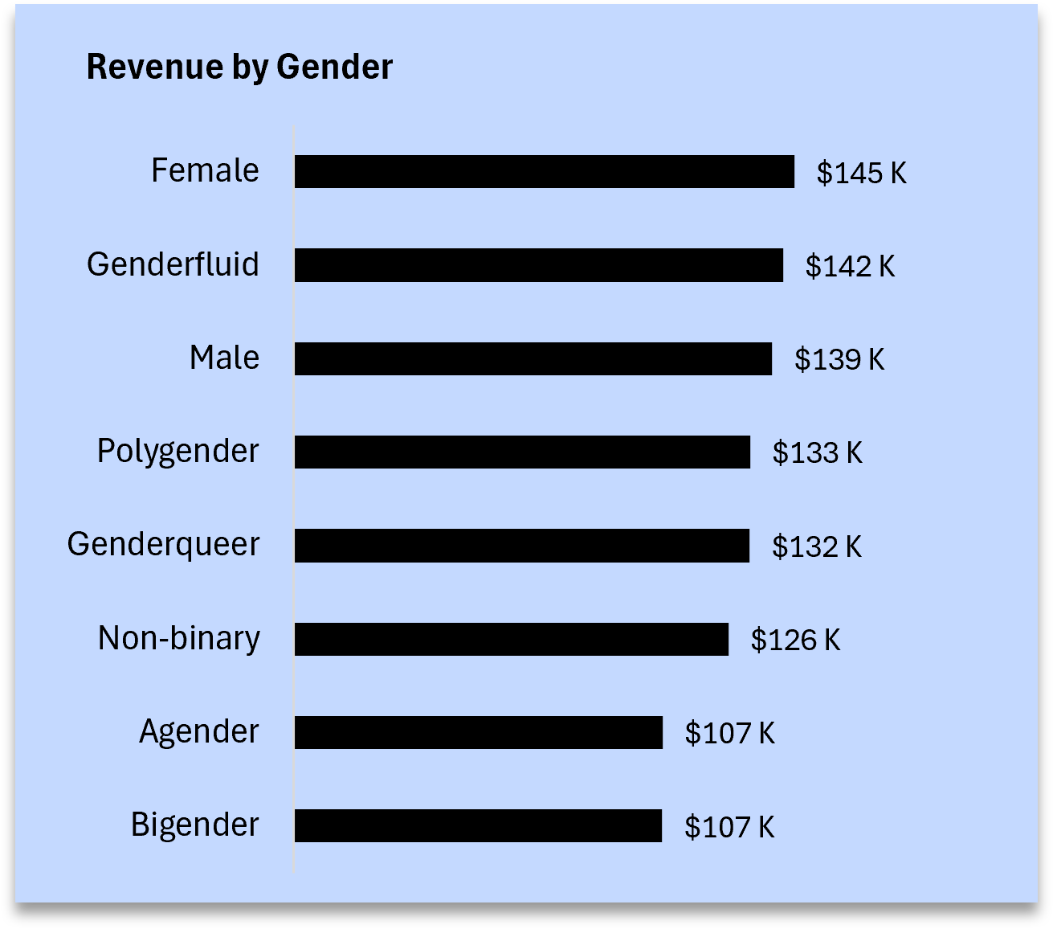
Key Findings
Orders by Gender:
Female & Genderfluid tied at 138 orders
Revenue by Gender:
Female: $145,404
Genderfluid: $142,077
Male: $138,988
Bigender: $107,014

Slide 12
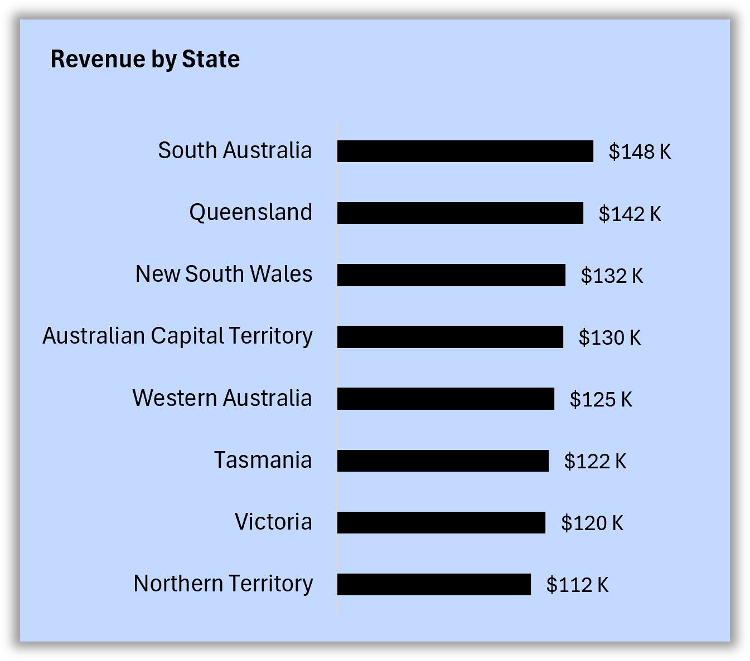
Key Findings
Top State: South Australia
139 customers, $147,816 in revenue
Top City by Revenue: Port Hannahburgh
$7,632 from very few customers (high spenders)
Lowest Region: Tasmania – lowest customer base and revenue

Slide 13
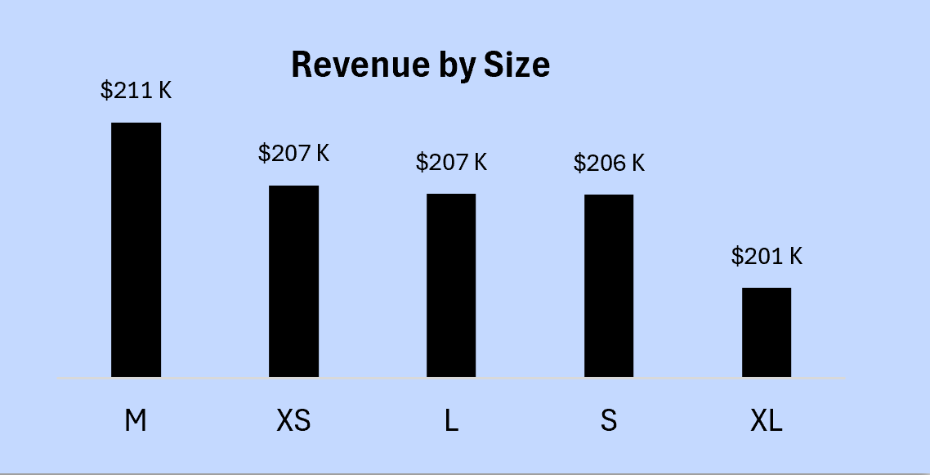
Key Findings
Top Size by Revenue: Medium ($211,018)
Top Color: Blue ($158,220)
Extra small also performs well in revenue ($207,093)

Slide 14
Recommendations
Replicate March Strategy: Promotions, campaigns or launches
Retention Tactics: Loyalty programs, Gen Z reactivation
Optimize Product Strategy: Raise jogger prices, focus on top sellers and sizes
Geographic Targeting: Boost effort in SA & underperformers like Tasmania
Highlight Fast Delivery Products: Use shirt delivery speed as a USP (Unique Selling Point)

Slide 15
Conclusion
Over the course of ten months, the e-commerce store demonstrated strong performance, generating over $1million in revenue from 1000 unique orders. At the heart of this success were Bommer customers, who emerged as the store most valuable demographics, alongside female and genderfluid shoppers who consistently drove higher revenue. Denim stood out as the star product, leading in both units sold and revenue, while cities like Port Hannahburgh despite a small customer base revealed the presence of high spending individuals.
However, revenue growth was unstable across months, with only a few standout periods like March, signaling the need for repeatable campaign strategies. Underperforming segments such as Gen Z and regions like Tasmania also revealed untapped potential.
By doubling down on high performing customer groups, refining product pricing strategies and replicating successful promotional models, the business is well positioned for lasting growth, stronger customer loyalty and improved profitability.

